Slide 1


TUTOR 24 X 7
Transforming NCERT Reading Subjects into Audio Learning Experiences

Slide 2
TUTOR 24 X 7
The Problem : Students optimize their best study hours.
High Priority
Mathematics
Physics
Chemistry
Often postponed
History
Geography
Environmental Science
Civics
Yet these subjects contribute equally to the final percentage.
The Solution : Students don't need to find additional study time—they simply convert idle time into productive revision.
Tutor 24 X 7 converts reading-intensive NCERT lessons into engaging audio lessons that students can consume during otherwise idle time.

Slide 3
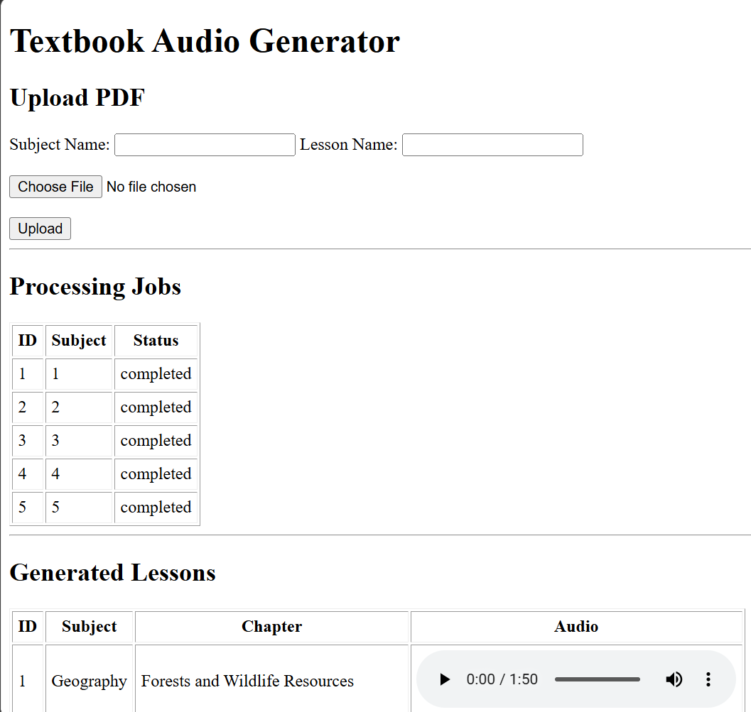
TUTOR 24 X 7
ADMIN Workflow
Upload NCERT PDF ↓ AI understands the lesson ↓ Creates student-friendly narration ↓ Generates natural voice audio ↓ Publishes lesson
Powered by AI Automatically transforms NCERT textbooks into natural, teacher-like narration.
No manual recording
No studio cost
AI automatically converts any new NCERT edition into structured audio lessons within minutes.

Slide 4
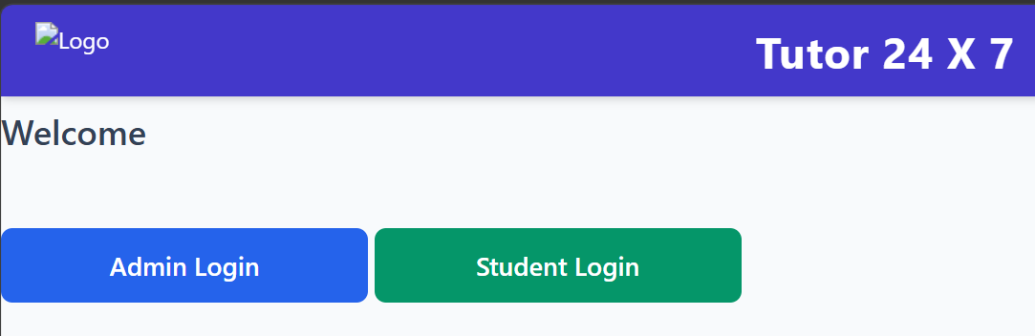
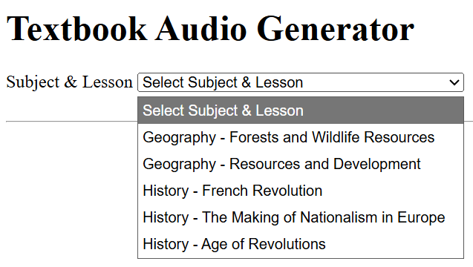
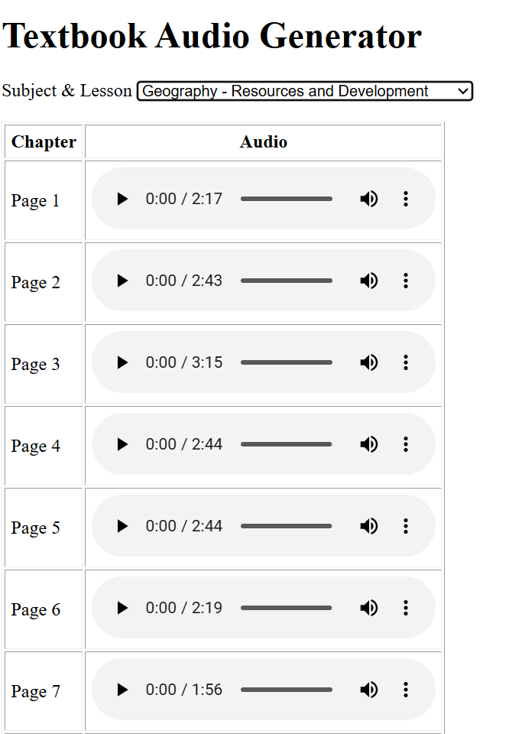

TUTOR 24 X 7
Student Workflow
Student Logs in
Selects desired subject & lesson from drop down
Plays individual section or entire lesson in sequence
Sample audio lesson
Study on the go
Affordable pricing
Repeated audio listening helps retention
Optimal use of time :
30 minute school commute
150 minutes of passive revision every week
Nearly 10 additional study hours every month

Slide 5
TUTOR 24 X 7
Business Opportunity
Revenue Model
Subscription
Rs 100 per month per subject
Typical student
History
Geography
Environment Science
Rs 300 / month
School licensing
EdTech platform integration
White-labelled solution
Why Now?
Growing adoption of audio learning
Students already consume educational content on mobile devices
AI enables rapid, low-cost content generation at scale
Why Audio Learning? ✓ Revision during commute ✓ Hands-free learning ✓ Repeated exposure improves retention ✓ Complements textbook learning
Every commute becomes a classroom.

Slide 6
TUTOR 24 X 7
Roadmap
Future Enhancements
✓ Hindi NCERT ✓ Other state boards ✓ Notes
✓ Quiz Generation
✓ Progress Tracking
✓ Parent Dashboard
Today ✓ English NCERT ✓ Classes 10–12 ✓ Audio lessons

Slide 7

TUTOR 24 X 7
About me
Ajit J Tawde
Mob : 91 986 018 6865
E Mail : ajit.tawde65@gmail.com
Linked In : https://www.linkedin.com/in/ajittawde/
Git Repo : atawde (Ajit Tawde)
Portfolio : Portfolio
25+ years in enterprise software architecture and consulting.
Extensive experience delivering large-scale technology solutions.
Built Tutor 24 X 7 to address a specific learning challenge for secondary school students.

